Slide 1

Bea Nemeth
11 February 2022
e-mail: bea.nemeth@yahoo.co.uk
Tel: +36204300732
https://github.com/green-fox-academy/beanemeth
Random spare time planner

Slide 2

The task
Caption
Let’s assume that you can never decide on what to do in your free time, but eagerly want to do something instead of laying in bed and hanging on social media or watching series all day. Therefore you decide to do random activities on random days in the future. You also like things organised and need a reference number for each activity generated so that you can log it in your diary.

Slide 3
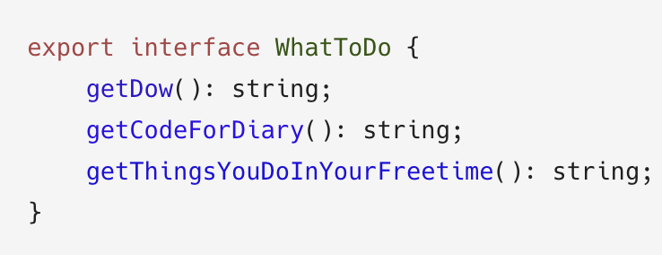
Solving the problem in three steps
Step 1: Get familiar with the interface given

Slide 4
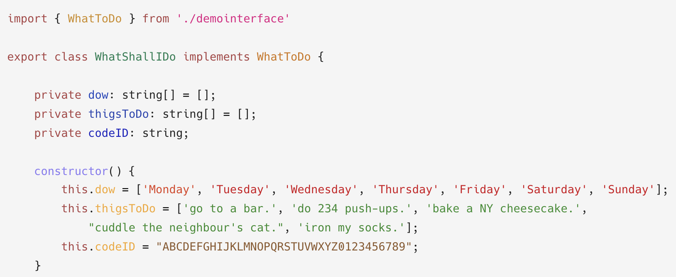
Step 2:
Create a class that implements
the given interface

Slide 5
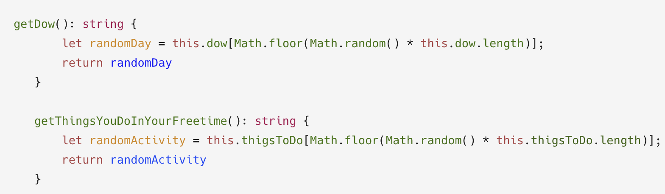
Step 3/1:
Use and complete the methods given in the interface

Slide 6
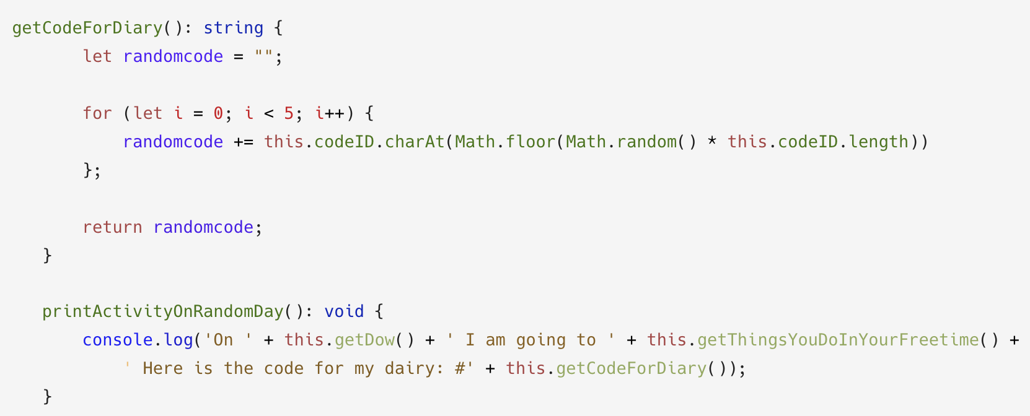
Step 3 / 2.
Create a method for the result to be printed

Slide 7
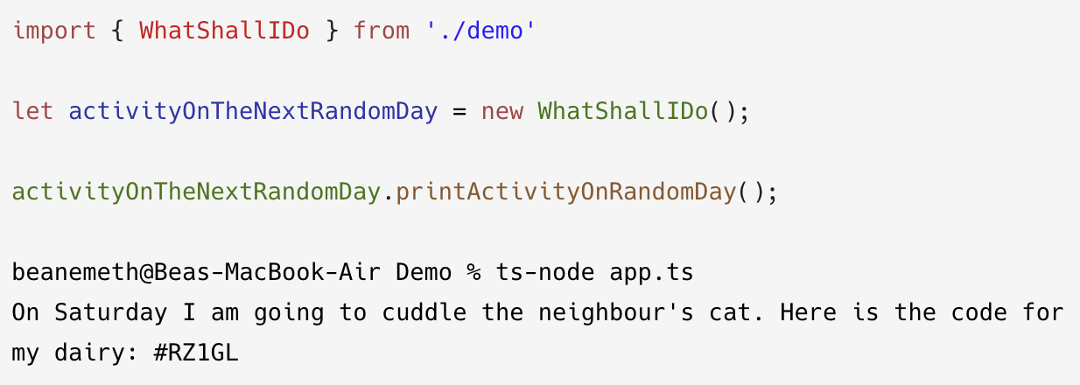
Here it goes!

Slide 8

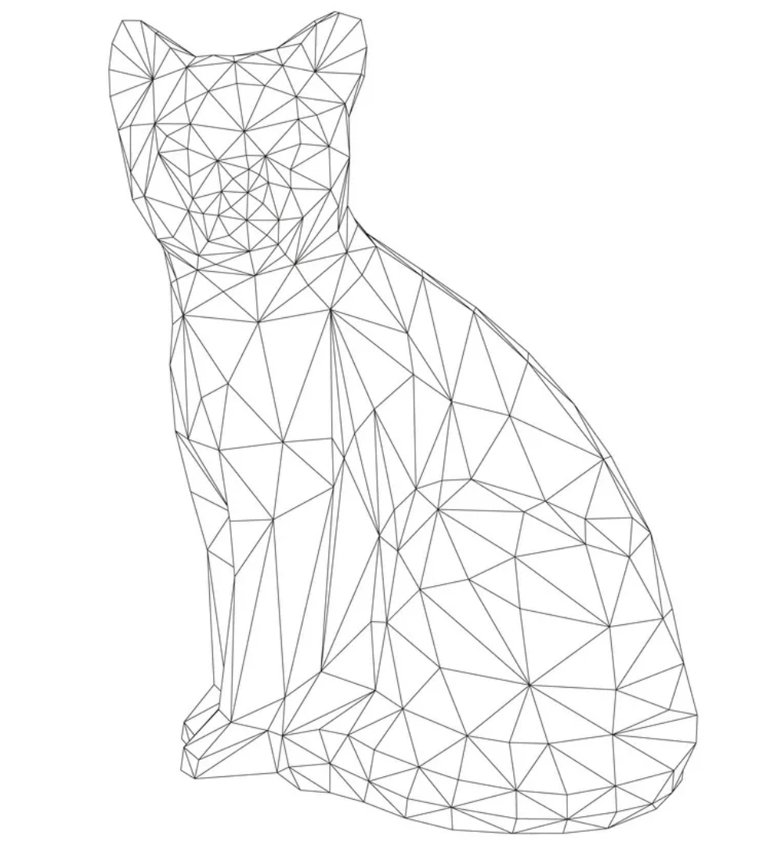
Self-improvements
Implementing an interface on a class
charAt()
Math.floor(Math.random())
Think outside of the box!

Slide 9

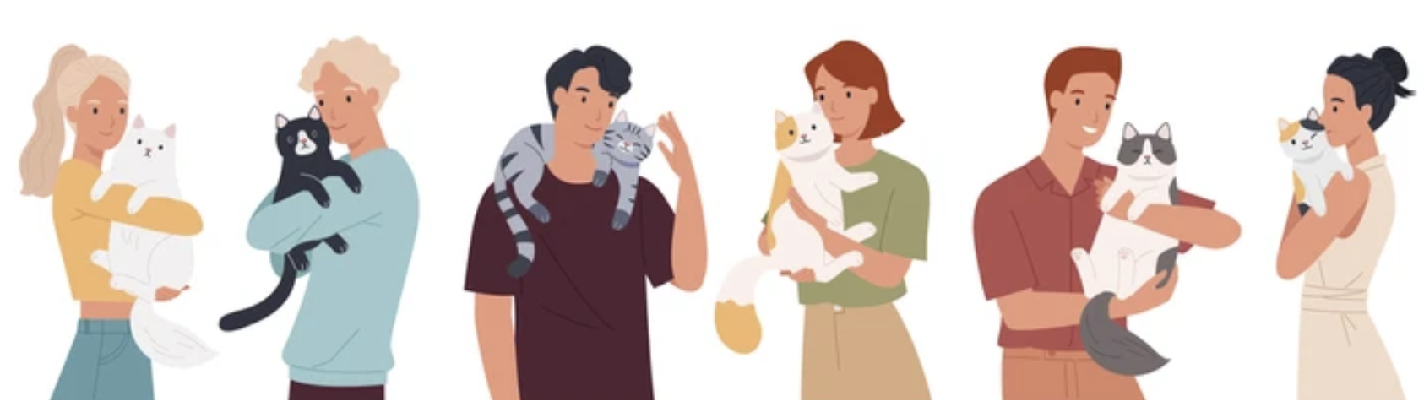
Thank you very much for your kind attention!

